Slide 1



R -Project work
- Dataset: Sleep health and lifestyle-

Slide 2

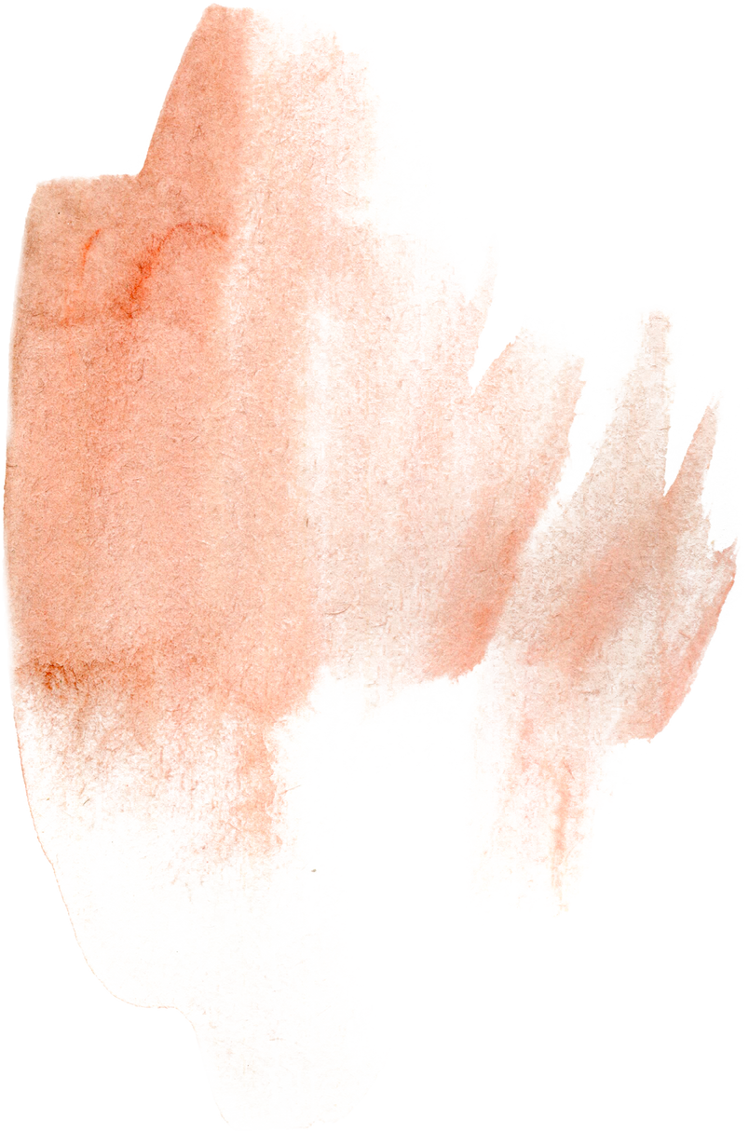



Contents
Introduction
Coding with R
Result

Slide 3

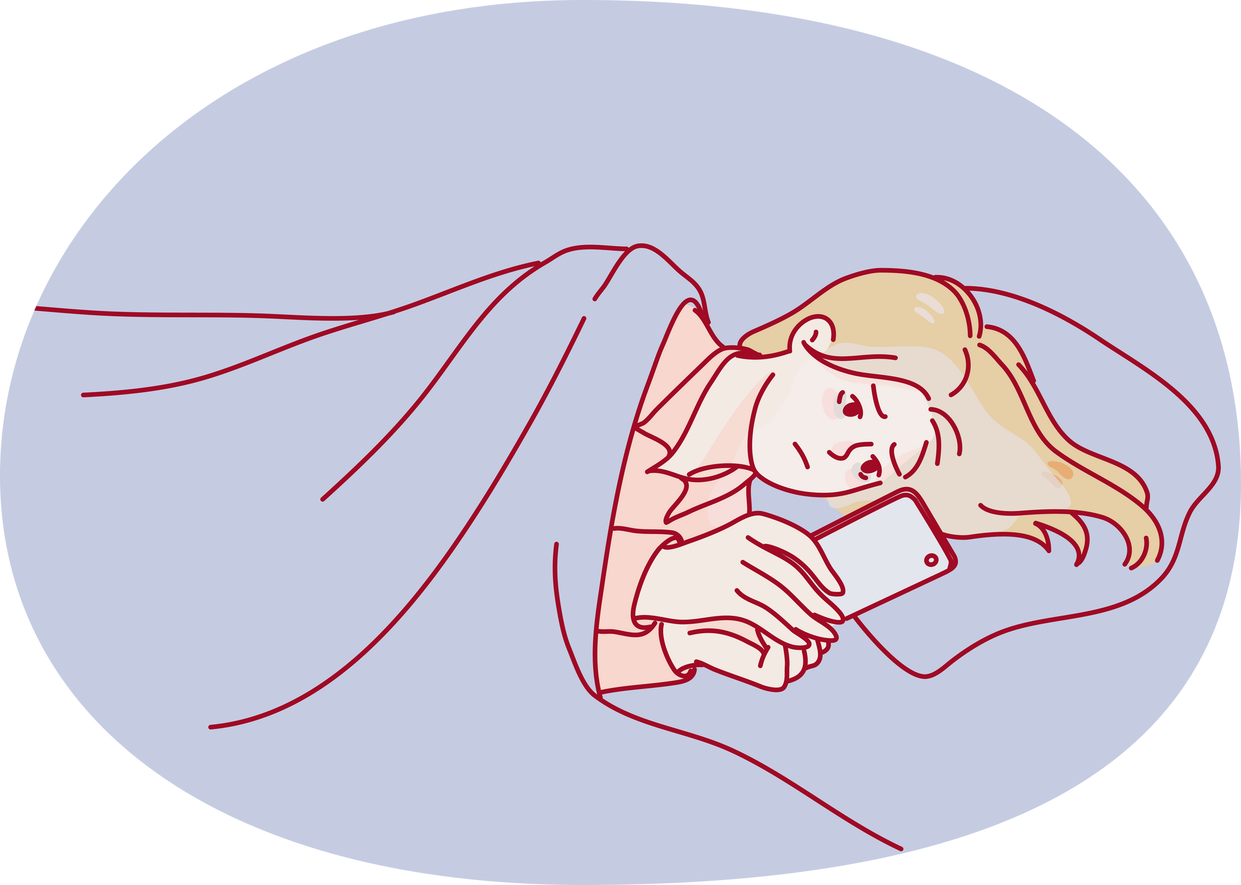

Introduction
ON
Dataset : sleep health and lifestyle
This project includes the analysis of sleep health and lifestyle dataset which is taken from Kaggle.
predicting stress levels using r program.
This dataset include comprises 400 rows and 13 columns.
It includes details such as gender, age, occupation, sleep duration, quality of sleep, physical activity level, stress levels, BMI category, blood pressure, heart rate, daily steps, and sleep disorders.

Slide 4
OverView
Sleep health analysis: Explore factors related to sleep duration
Lifestyle factors analysis: Investigate physical activity levels, stress levels, and BMI categories.
Cardiovascular health analysis: Examine blood pressure and resting heart rate measurements.
Sleep disorder analysis: Determine the presence of sleep disorders such as insomnia and sleep apnea.
T
For adults minimum 8 hours of sleep is required.
Stress Level (scale: 1-10): A subjective rating of the stress level experienced by the person, ranging from 1 to 10.
BMI Category: The BMI category of the person (e.g., Underweight, Normal, Overweight).
A normal blood pressure reading for an adult is blood pressure that’s below 120/80 mm Hg and above 90/60 mm Hg
A None: No specific sleep disorder.
Insomnia: The individual experiences difficulty falling asleep or staying asleep
Sleep Apnea: The individual suffers from pauses in breathing during sleep, resulting in disrupted sleep patterns and potential health risks.

Slide 5




Coding
INSTALLING THE LIBRARY
install.packages("ggplot2")
install.packages("dplyr")
install.packages("ISLR")
install.packages("forcats")
install.packages("hrbrthemes")
IMPORTING THE LIBRARY
Library(ggplot2)
Library("dpylr")
Library("ISLR")
library(forcats)
library(hrbrthemes)
used for Visualization
Grammer data manipulation
For dataset
solve common problems with factors
Additional Themes,Components for ggplot2

Slide 6
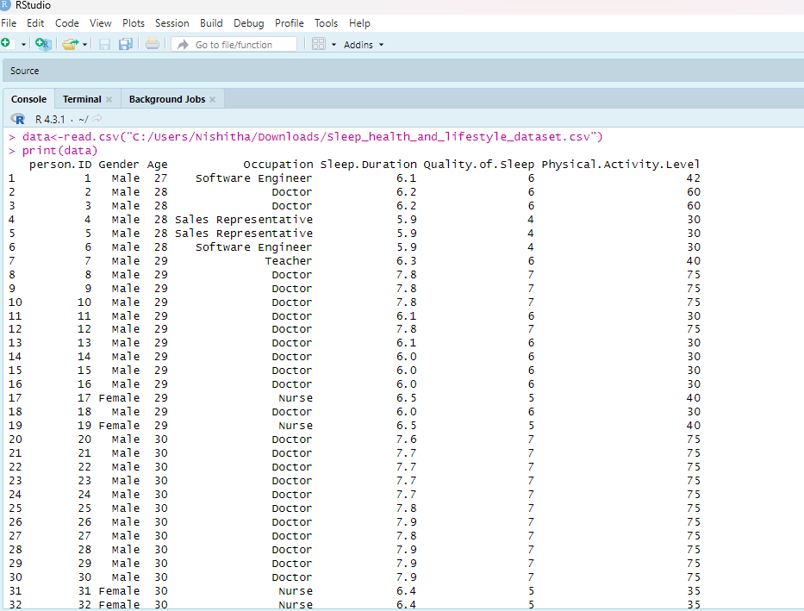

IMPORT THE DATASET
data<-read.csv("C:/Users/Nishitha/Downloads/Sleep_health_and_lifestyle_dataset.csv")
print(data)
HEAD
head(data)
Here first six elements of data is displayed for the user

Slide 7
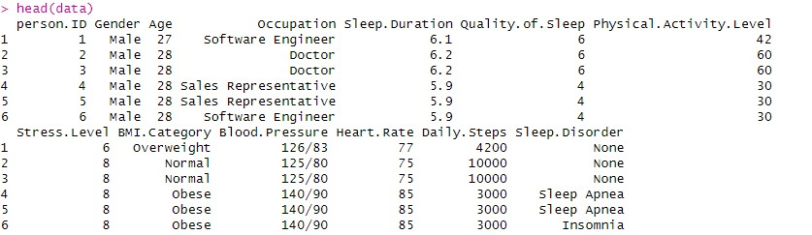
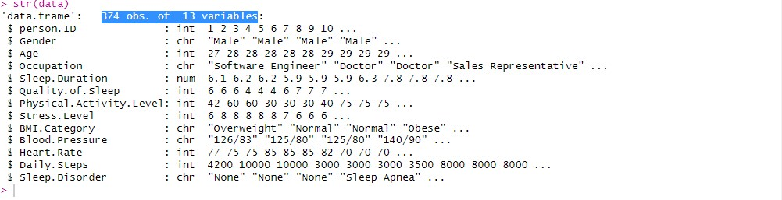

STR
Str(data)
str is nothing but display the internal structure of data
In sleep dataset : 374 obs. of 13 variables

Slide 8

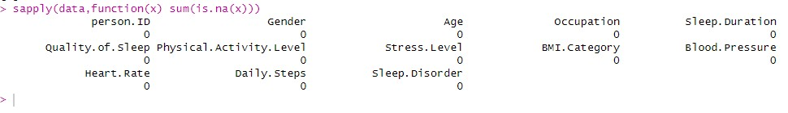
DISPLAYING THE ROW AND COLUMNS
dim(data)
[1] 374 13
There are 374 rows and 13 column
No null or missing values are found in this dataset
FINDING NULL VALUES
sapply(data,function(x) sum(is.na(x)))

Slide 9

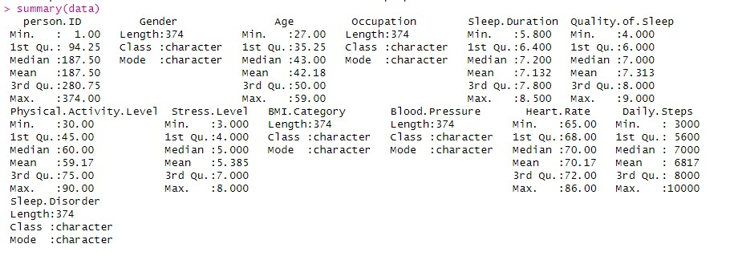
SUMMARY OF DATASET
summary(data)
Summary of sleep dataset gives us a mean ,median ,mode
1 and 3 quartile

Slide 10

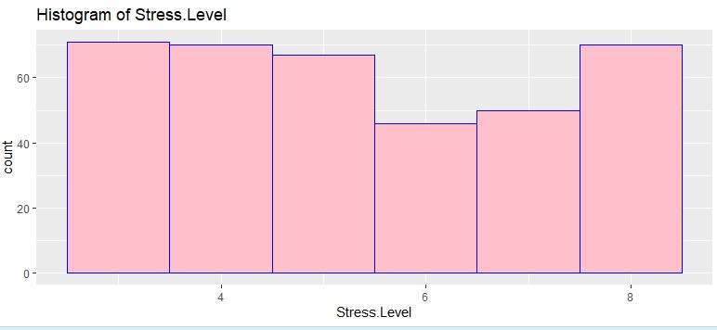

Visualize of a dataset
ggplot(data, aes(x=Stress.Level)) +
geom_histogram(fill="pink", color="blue",bins=6) +
ggtitle("Histogram of Stress.Level")
here x is taken as stress level

Slide 11
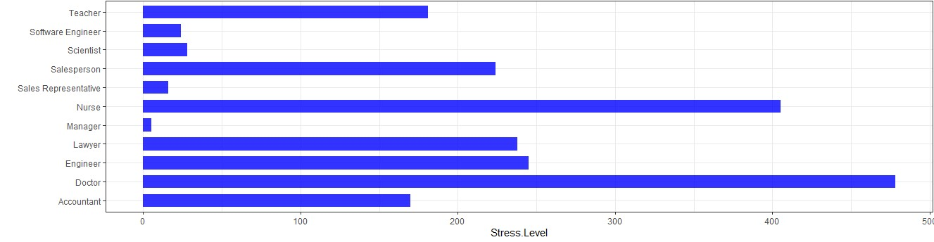
BAR GRAPH
data %>%
ggplot( aes(x=Occupation, y=Stress.Level)) +
geom_bar(stat="identity", fill="blue", alpha=.8, width=.7) +
coord_flip() +
xlab("") +
theme_bw()
Here in this graph we can find that stress level is more in doctor and Nurse and least in manager

Slide 12
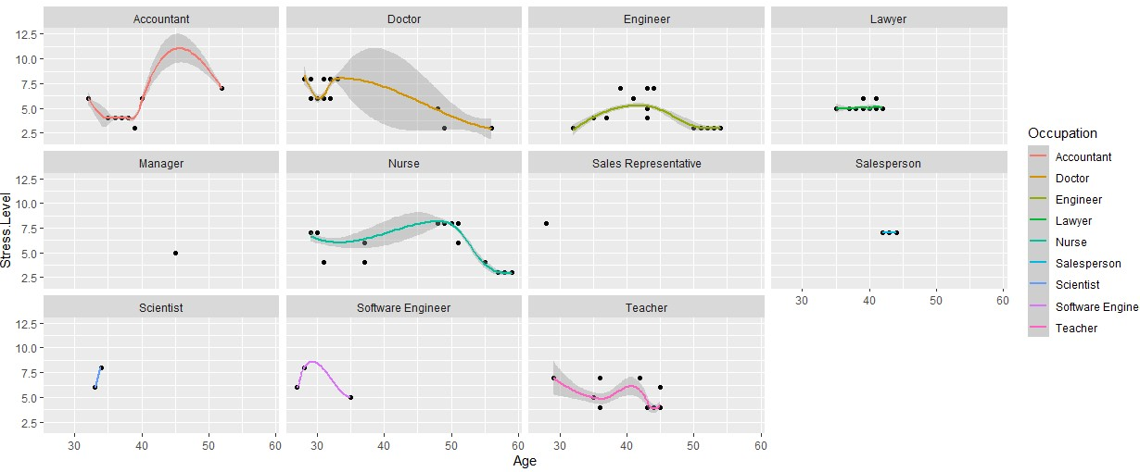
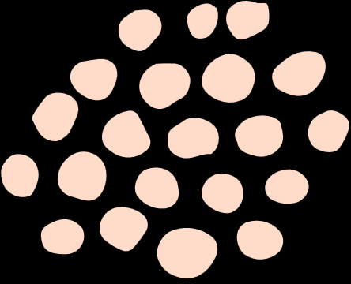
MAPING
ggplot(data = data, mapping = aes(x =Age, y = Stress.Level)) +
geom_point() +
geom_smooth(aes(color = Occupation)) +
facet_wrap( ~ Occupation)
Doctors and nurses -from early 20s to late 50s there are stress level are high
Teacher-late 20s to mid 40s there are stress high
lawyer-have a stagnant stress level
software engineer and manager- have less stress level

Slide 13
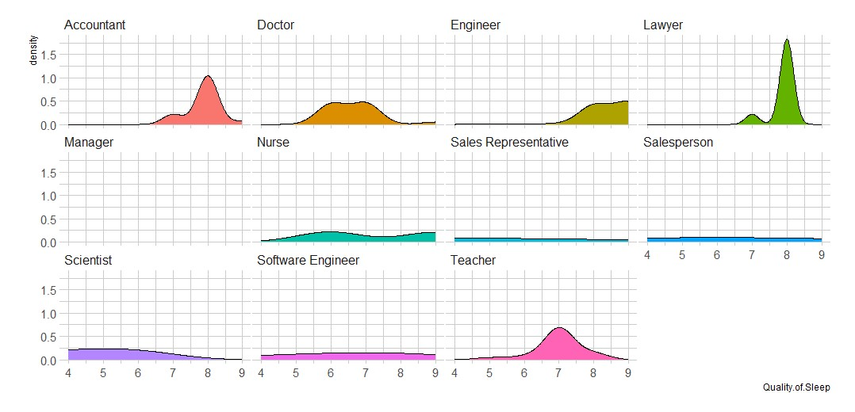
plot(data, aes(x=Sleep.Duration, group=Occupation,, fill=Occupation,)) +
geom_density(adjust=1.5) +
theme_ipsum() +
facet_wrap(~Occupation,) +
theme(
legend.position="none",
panel.spacing = unit(0.1, "lines"),
)
Here doctors and nurses have least sleep duration sales and accountant have good amount sleep duration

Slide 14
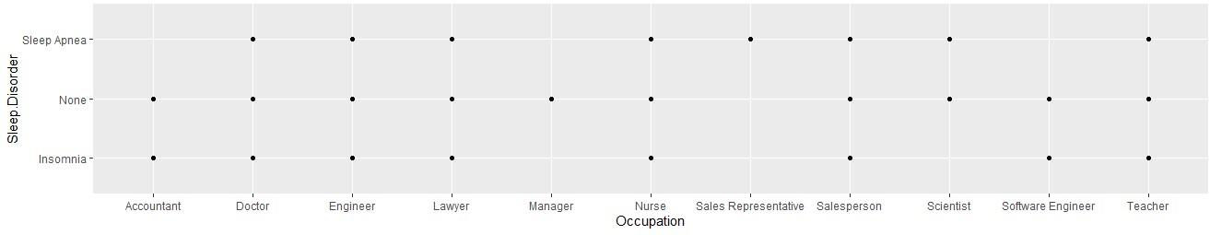
ggplot(data, aes(x=Occupation, y=Sleep.Disorder)) + geom_point()

Slide 15
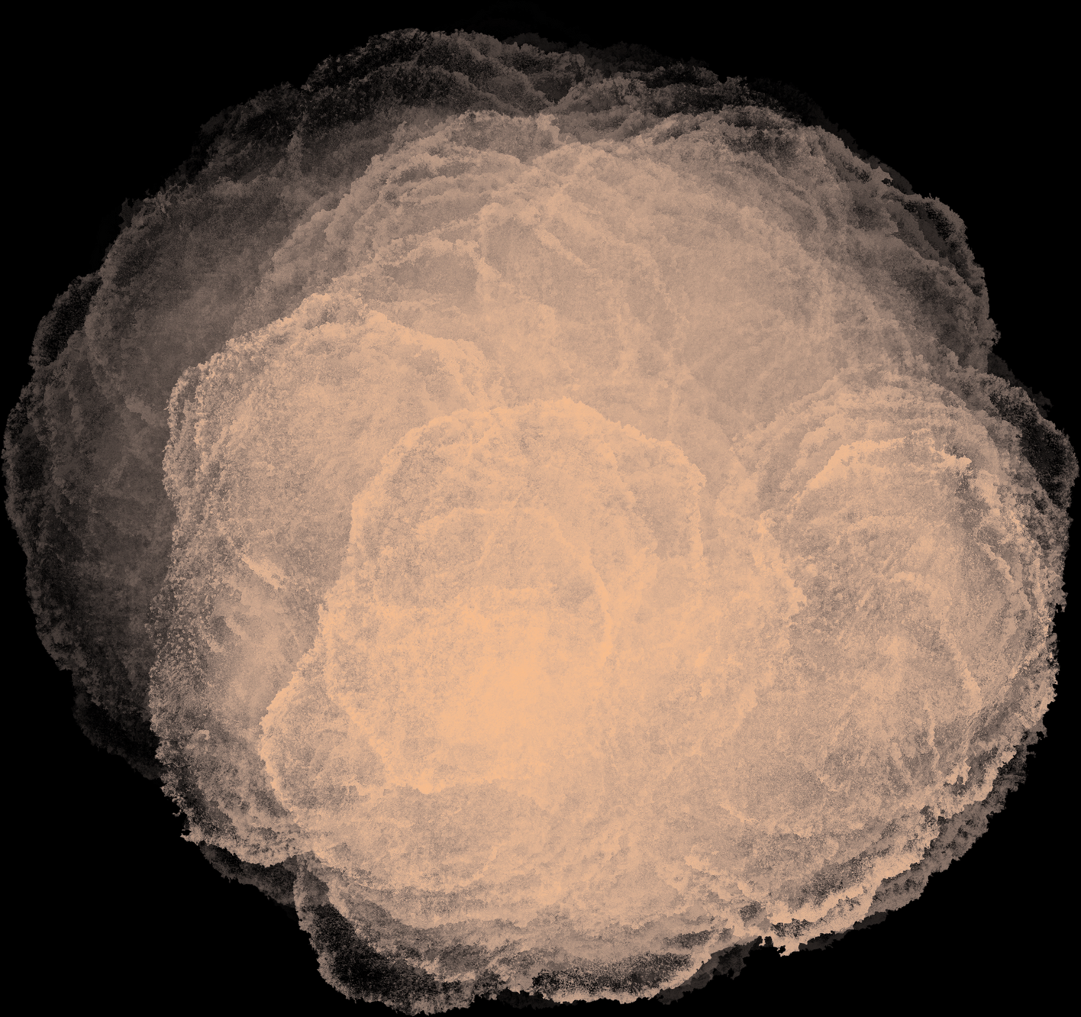
Thank
you

